Slide 1
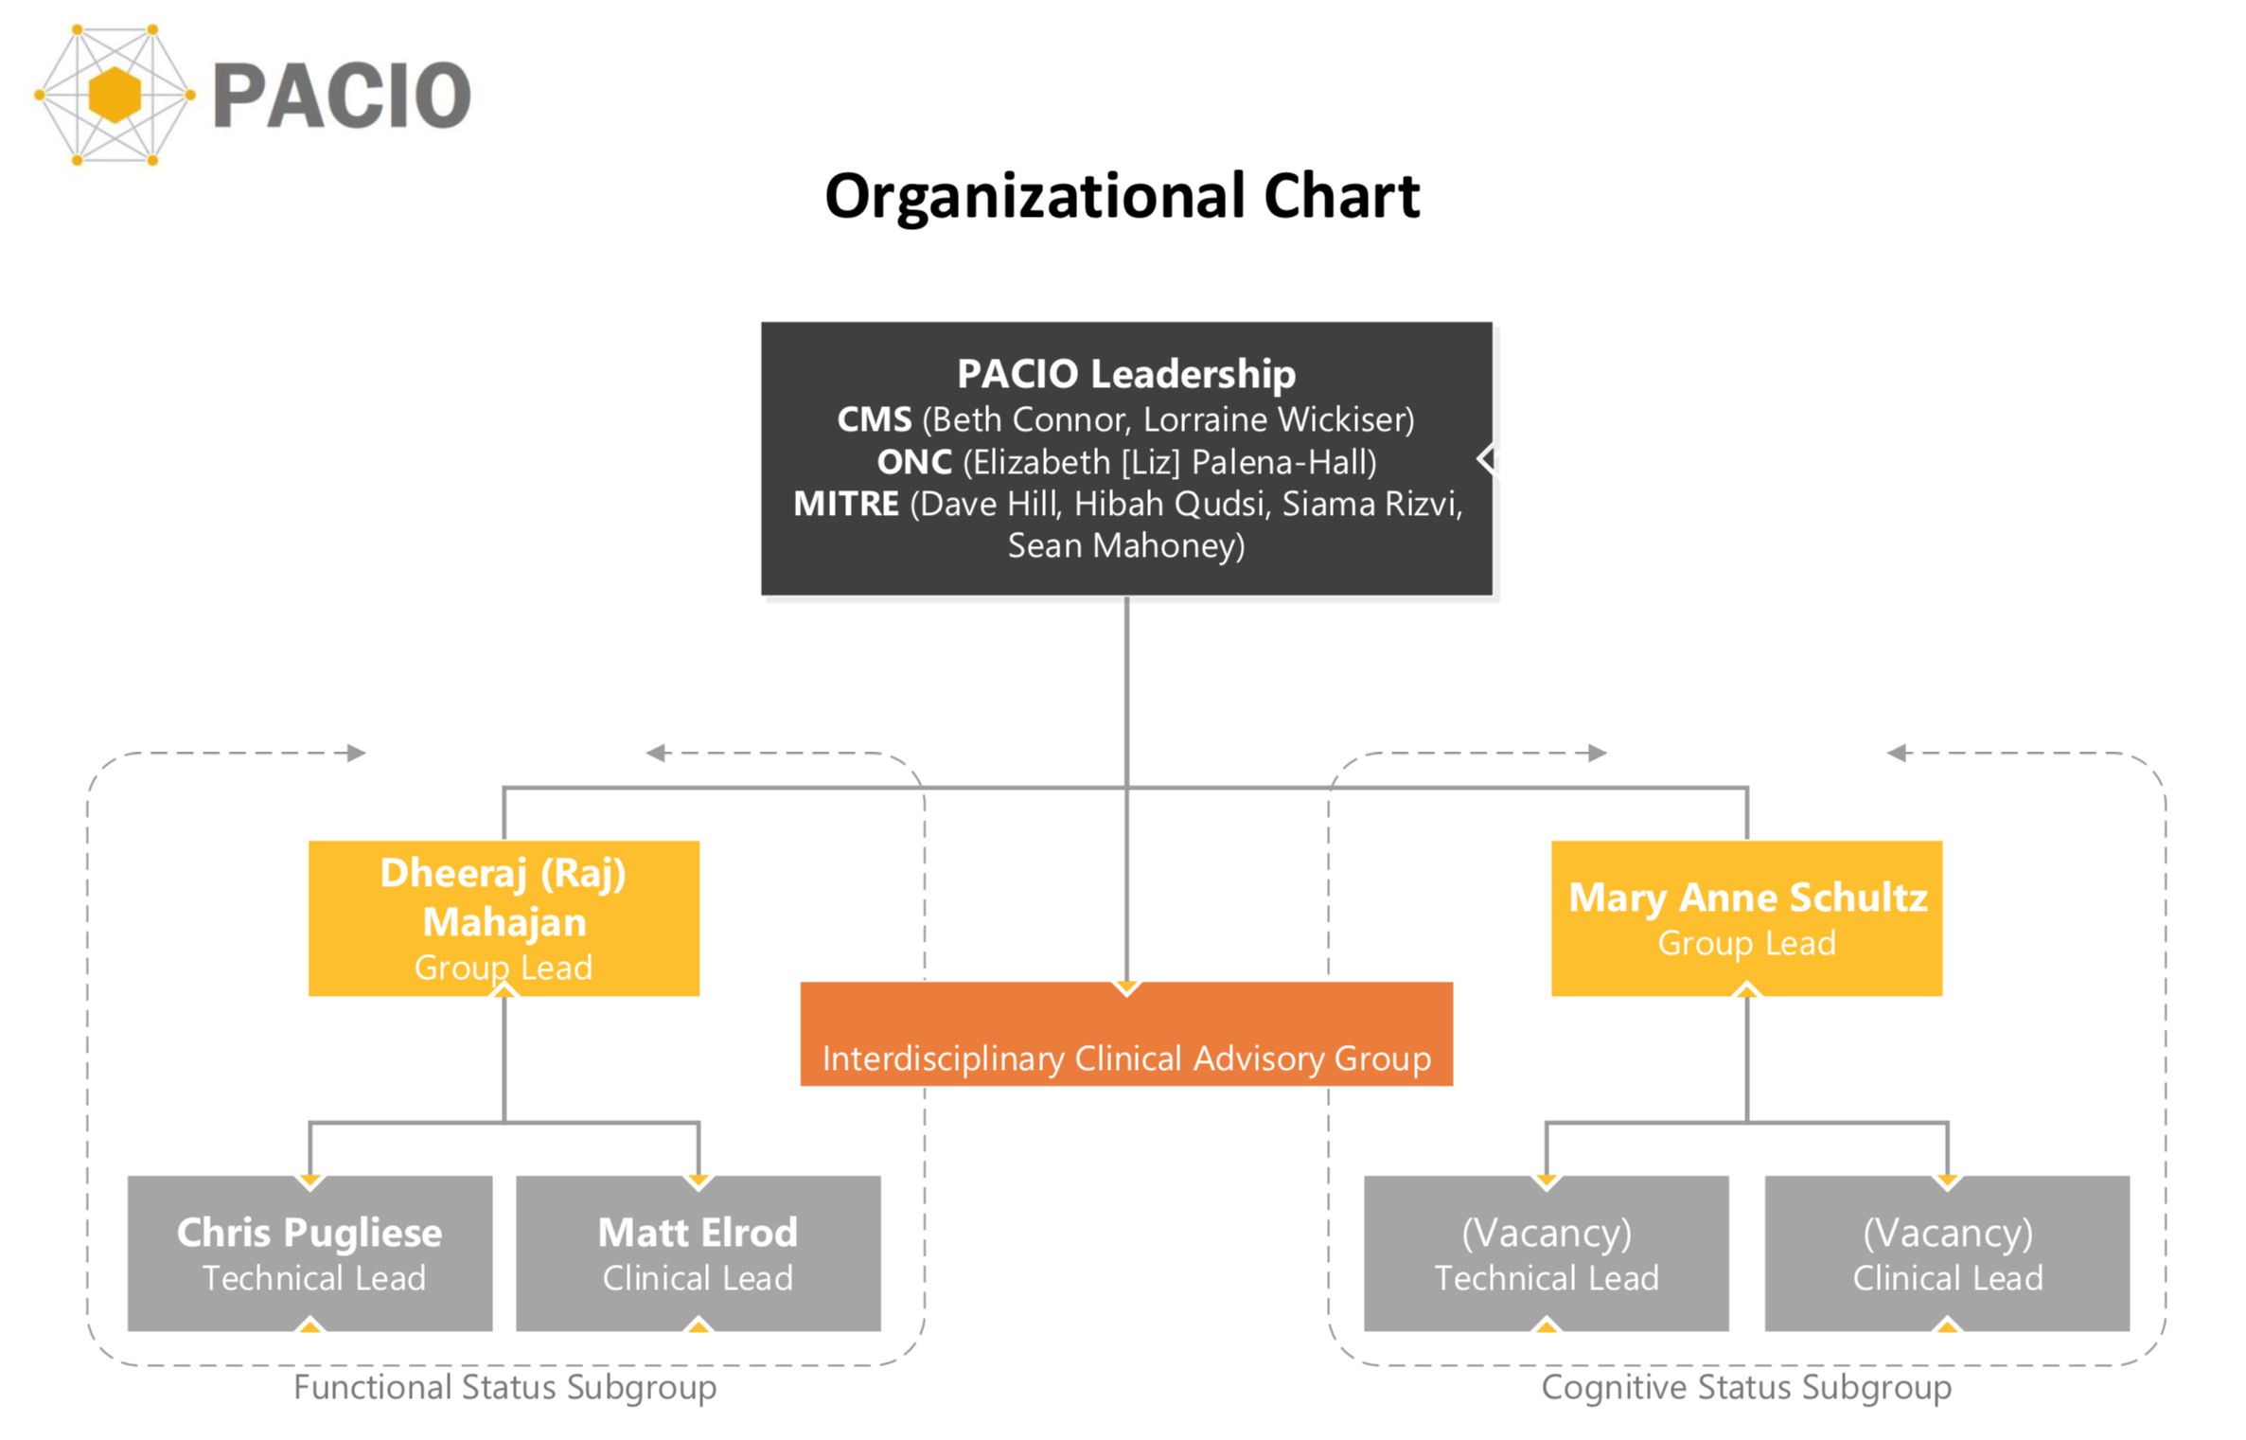

Slide 2
Collaborative Care and HIT Innovation Summit

Slide 3
HIMSS20 Interoperability Showcase Demo
HIMSS 2020 – March 9-13, 2020 in Orlando, FL
Timeline
July 22nd – webinar to announce topic areas
October – beginning of weekly sessions with development team
January – face-to-face meeting in Cleveland, OH to show demo to HIMSS reviewers
HIMSS 2020 – demo every hour at Interoperability Showcase (45-50 demos)

Slide 4
Functional Status Progress
Continued working on data model
Spreadsheet created by Rachel Lopez, NIC created
Section G, Section GG, cross-setting data elements, FASI
Reached agreement that the spreadsheet captured elements
Working on prioritizing elements
Donna Doneski working with NASL members to prioritize
Walked group through Implementation Guide & Reference Implementation example
Medical Formularies
What needs to be done for functional status
Started subgroup leadership transition

